Slide 1
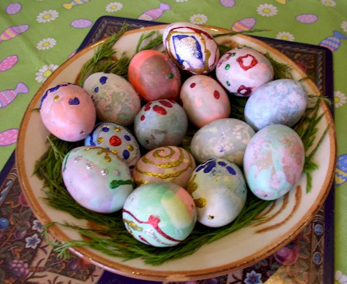
Christian Festivals: Easter
Holiest week of Christian calendar.
Warning: Dates may vary.

Slide 2
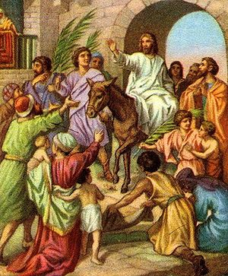
Palm Sunday
Sunday before Easter Sunday. When Jesus entered Jerusalem on a donkey. His followers spread palm branches in his path.

Slide 3
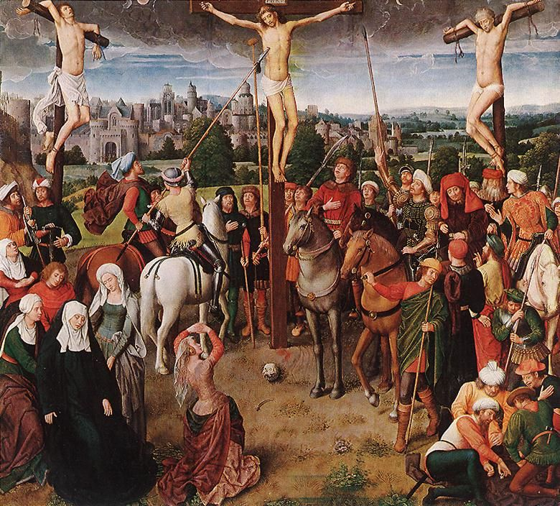
Good Friday
Crucifixion “affixed to the cross”
Between two criminals
INRI posted on his cross
Soldiers cast lots for his clothes.
(Hans Melming, 1500s)

Slide 4
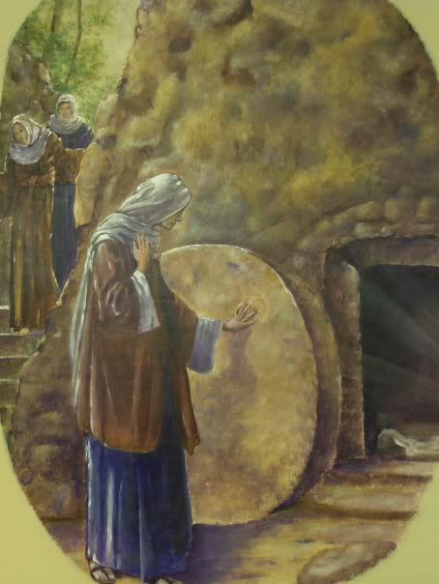
Easter Sunday
The first Sunday after the first full moon after the spring equinox. Why?
Christ’s resurrection.
(Question: Who discovered the tomb was empty?)

Slide 5
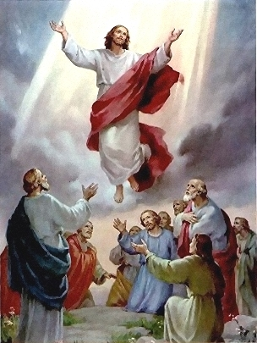
Ascension
Jesus ascends into heaven 40 days after Resurrection on a mountaintop
(Question: Who else was there?)

Slide 6
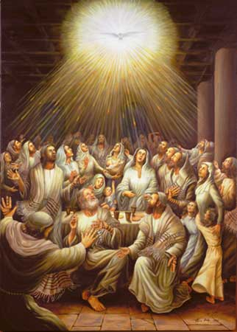
Pentecost
10 days after Ascension
The start of the Christian church.

Slide 7
Sacred Writings
The New Testament
1. The 4 Gospels
2. Acts of the Apostles
3. Letters to Churches (Epistles)
4. Revelations

Slide 8
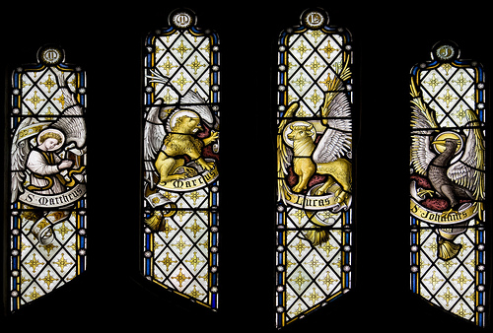
Angel, Lion, Ox, Eagle

Slide 9
The Gospels: Mark
Written ~70 CE?
Associated with Paul and Peter.
The earliest gospel.
Shortest gospel.
No Nativity.
Most of Mark is incorporated in Matthew and Luke.

Slide 10
The Gospels: Matthew
Written ~80 CE?
Apostle, Jewish tax collector
Connects Jesus to Old testament prophecy
Has the Nativity story
Has the Sermon on the mount.

Slide 11
The Gospels: Luke
Written ~85 CE?
A Greek Christian connected to Paul
Well educated, a Physician
Has the Nativity story
Many stories of healing the sick

Slide 12
The Gospels: John
Written ~100 CE?
A follower of the apostle John?
The “Gnostic” gospel
More philosophical than the others

Slide 13
Acts of the Apostles
Also written by Luke ~70CE
Chronicles the missionary work of Peter and Paul in the early years of the church.
Emphasizes the Holy Spirit

Slide 14
Epistles
Earliest works of the New Testament
Mostly written by Paul ~ 50s and 60s CE
Sent to Christian communities all over the Mediterranean.

Slide 15
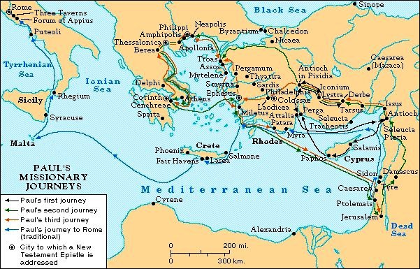
Paul’s Journeys

Slide 16
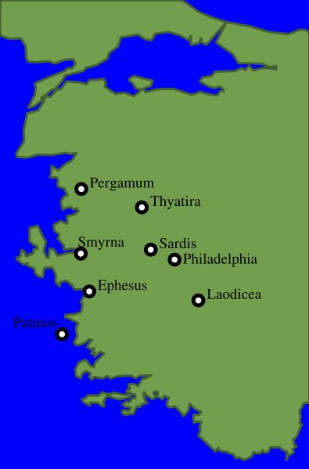
Book of Revelations
“John” (not the apostle) ~95CE
Written on the Isle of Patmos to “The Seven Churches of Asia.”
Apocalyptic text predicting the imminent end of the world

Slide 17
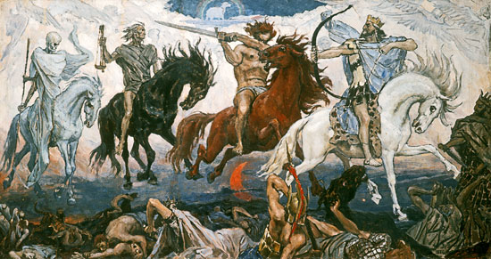
The Four Horsemen of the Apocalypse

