Slide 1
Christianity:
The world’s most successful religion
Over 2 billion people call themselves Christians (1/3 of the planet)
Began as a Jewish sect which spread through the Roman empire

Slide 2
Jesus
Born 4 BCE in Judea, a Roman province
Hebrew name,Yeshua ben Miriam (“Joshua, son of Mary”)
Jesus of Nazareth, a preacher for three years, before being crucified by the Roman authorities.
Jesus did not write anything down. His followers wrote the new testament

Slide 3
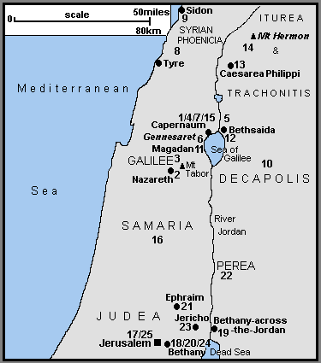
Early Life
Christ born in Bethlehem
Raised in Nazareth near the Sea of Galilee

Slide 4
Family Life
Parents Joseph and Mary
Many brothers and sisters
Father a carpenter
Story of Jesus begins at age 30

Slide 5
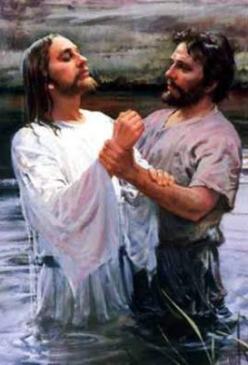
John The Baptist
Jesus baptism in the river Jordan by John the Baptist
Gospel of Mark: Chapter 1 (the oldest gospel)

Slide 6
Jesus’ Ministry
John the Baptist is arrested
Jesus retreats to the desert for 40 days to fast and pray
He is tempted by Satan
He returns and begins preaching that people must repent to prepare for the kingdom of God

Slide 7
For three years Jesus preaches
He performs miracles
He heals the sick
Heads to Jerusalem for Passover

Slide 8
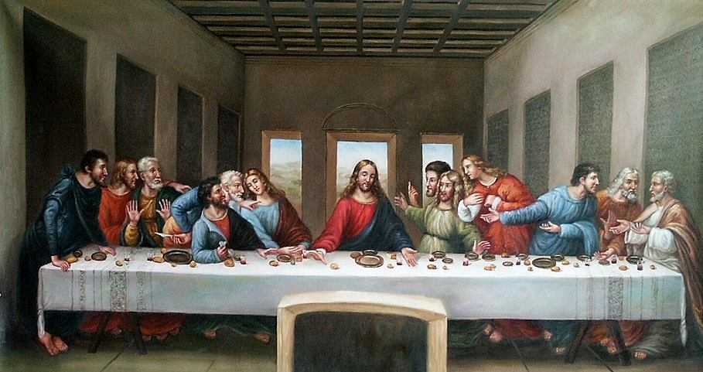
The Last Supper
Jesus and the disciples share the Passover meal in Jerusalem

Slide 9
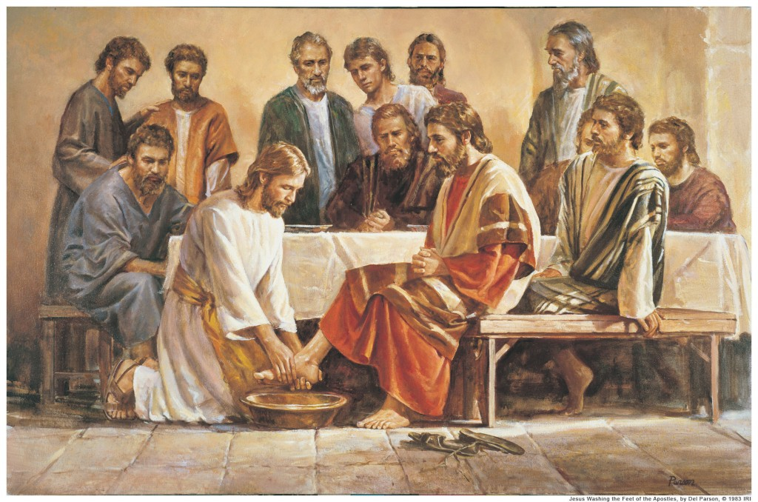
Jesus washes the feet of the disciples

Slide 10
Crucifixion
Jesus is arrested
Tried for sedition
Sentenced to death
Crucified

Slide 11
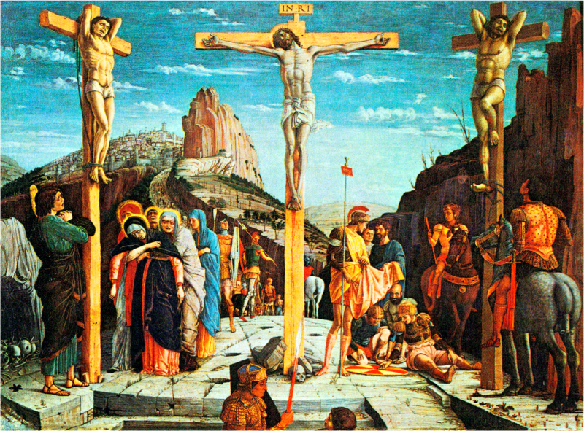

Slide 12
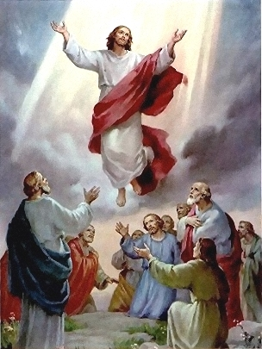
Resurrection and Ascension
Jesus is raised from the dead
Ascends to heaven 40 days after the resurrection

Slide 13
Day of Pentecost
Ten days after the Ascension, fifty days after Easter Sunday, Jesus followers meet in an upper room
They share a religious experience, Christianity is born
They begin to spread Christ’s teachings

Slide 14
Roman Empire
Christianity spreads through the Roman Empire
Many episodes of persecution and martyrdom

Slide 15
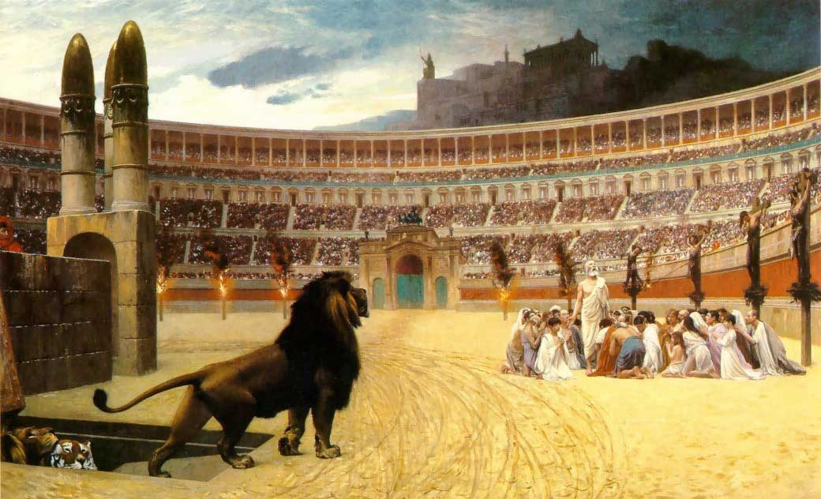
Thrown to the Lions

Slide 16
Council of Nicea
By the early 300s, 10% of Roman citizens are Christians
Emperor Constantine assembles all the Bishops at Nicea 325 AD
They hammer out the Nicene Creed
They determine which books will become the bible
The Nicene Creed

Slide 17
What Christians Believe: The Nicene Creed 325 AD
I believe in one God, the Father Almighty, Maker of heaven and earth, and of all things visible and invisible.
And in one Lord Jesus Christ, the only-begotten Son of God, begotten of the Father before all worlds; God of God, Light of Light, very God of very God; begotten, not made, being of one substance with the Father, by whom all things were made.
Who, for us men and for our salvation, came down from heaven, and was incarnate by the Holy Spirit of the virgin Mary, and was made man; and was crucified also for us under Pontius Pilate; He suffered and was buried; and the third day He rose again, according to the Scriptures; and ascended into heaven, and sits on the right hand of the Father; and He shall come again, with glory, to judge the quick and the dead; whose kingdom shall have no end.
And I believe in the Holy Ghost, the Lord and Giver of Life; who proceeds from the Father and the Son; who with the Father and the Son together is worshipped and glorified; who spoke by the prophets.
And I believe in one holy catholic and apostolic Church. I acknowledge one baptism for the remission of sins; and I look for the resurrection of the dead, and the life of the world to come. Amen.

Slide 18
The Nicene Creed 325 -381 AD
The fathers of the first council of Nicea 325 A.D.

Slide 19
Holy Communion
The Holy Eucharist:
Evolved from a communal meal in a home
Bread and wine = body and blood of Christ
“Transubstantion” – the “host” becomes the actual body and blood of Christ

Slide 20
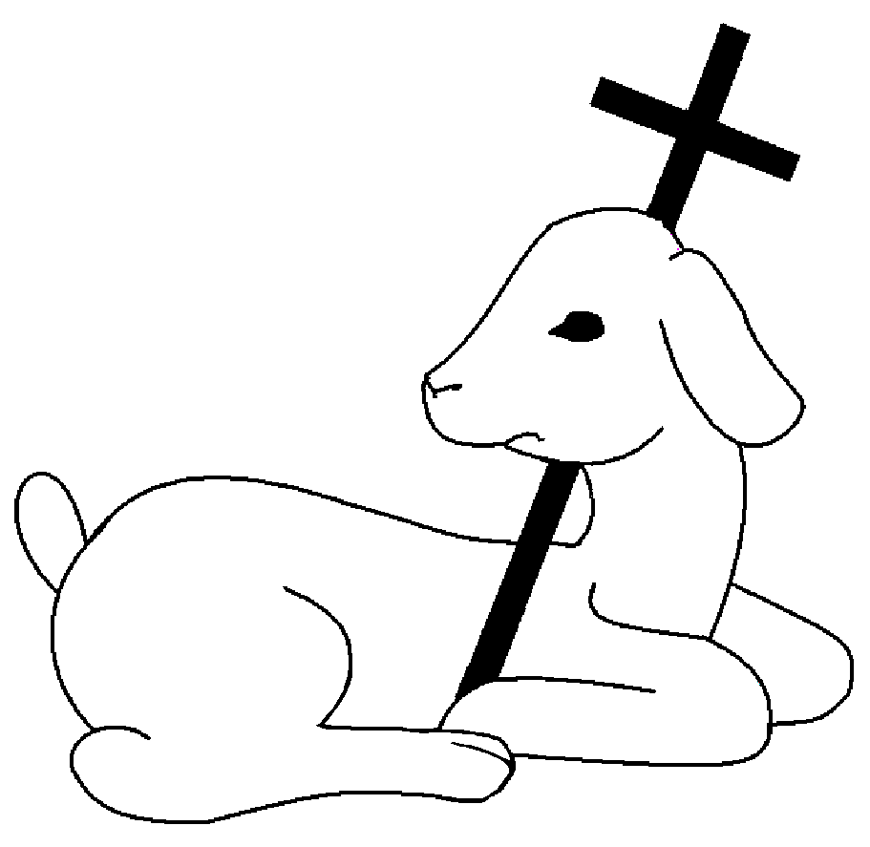
Christian Symbols
The lamb of God

Slide 21
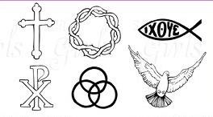
Cross, Crown of thorns, Fish,
Chi-Rho, Trinity, Dove

Slide 22
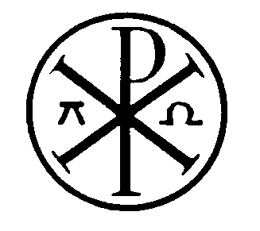
The Alpha and the Omega

Slide 23
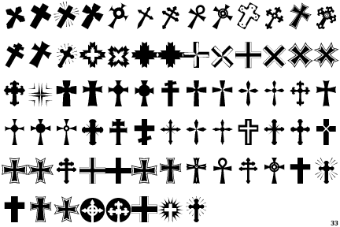
The Cross

Slide 24
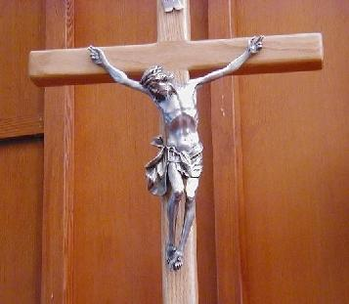
Catholic Cross
End. P. 280

