Slide 1
Islam: Part I
World Religions 3106

Slide 2
What is Islam?
Islam: “Submission to God.”
Muslim: “One who submits to God.”
The Shahada: “There is no God but God, and Muhammad is his prophet.” (Compare to Torah)
Numbers: Textbook says 1.2 billion. Wikipedia says 1.3 – 1.6 billion.
Canada: 1 million (out of 33 million)

Slide 3
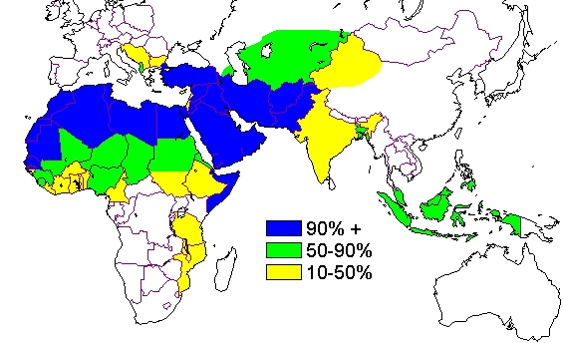
Islamic Countries

Slide 4
Where did Islam Originate?
Muhammad was born in Mecca in 570 CE (i.e. AD), in Arabia.
Arab tribes were Polytheists.
Practiced Idolatry.
Each tribe had an idol kept in the Ka’bah, today the holiest site in Islam. Muslims believe that Abraham built it (2000 BCE).

Slide 5
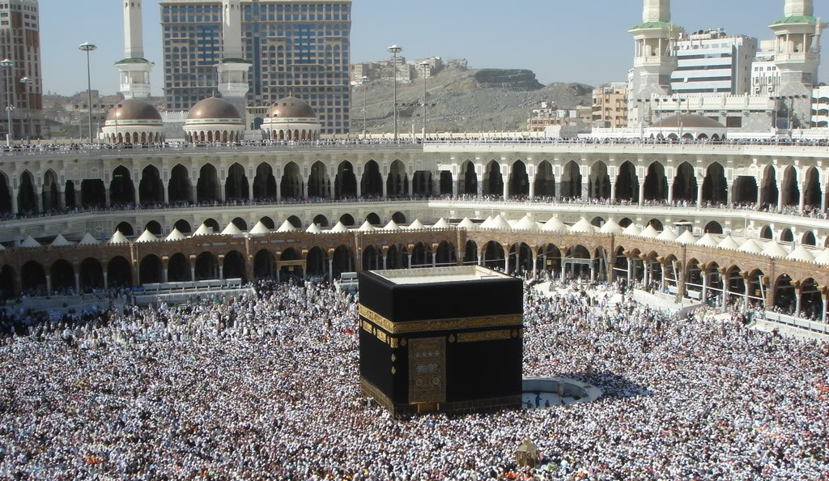
The Ka’bah in Mecca

Slide 6
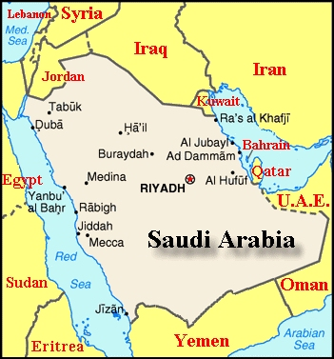
Saudi Arabia
Mecca was a trade city on the Red Sea
Medina

Slide 7
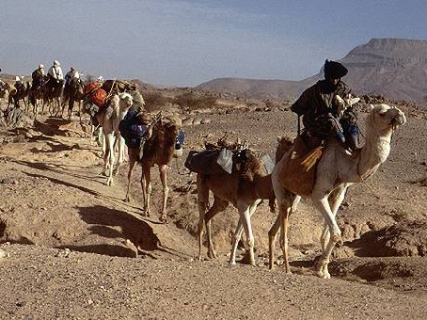
Muhammad
Born into the Quraysh tribe (big shots)
Orphaned at age 6, raised by relatives
Trained as a traveling merchant in caravans
Always preferred Monotheism to the Polytheism and Idol worship around him.
Age 20, met and married wealthy 35 year old widow Khadija.

Slide 8
revelation
In 610, during Ramadan, on retreat at age 40 on Mount Hira, Muhammad received a revelation.
The angel Gabriel appeared to him and commanded him to recite.
For the rest of his life he received revelations.
These were passed on orally to his followers
After his death they were written down in the Quran (Koran)

Slide 9
Prophet
He spoke out against Idols.
He said there was only one God.
This angered the people who controlled the Ka’bah, which was an important pilgrimage site for the Arab tribes.
In 619, his wife died.
Her tribal influence no longer protected him.

Slide 10
Night Journey and Ascension
Muhammad was taken by Gabriel to Jerusalem on a winged horse.
Once at the site where Abraham bound his son (Muslims believe it was Ishmael, the ancestor of all Arabs), they ascended through the heavens.
They met Adam in level I
They met John (the baptist) and Jesus in level II
Then Joseph, Enoch, Aaron, Moses, and Abraham.
Muhammad was told how to pray.

Slide 11
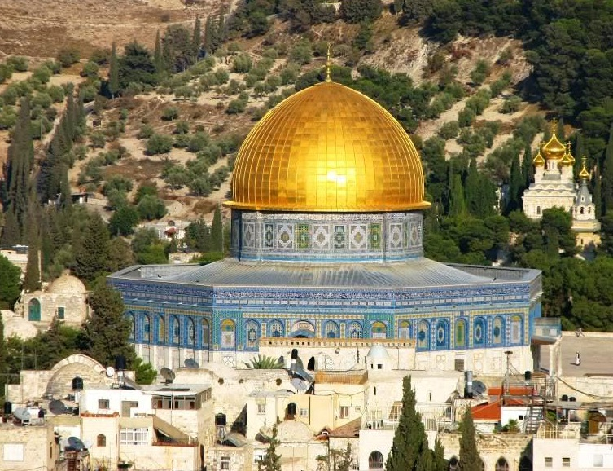
Dome of the Rock/ Al Aqsa Mosque
Built on the site of the Ascension
In 689-691

Slide 12
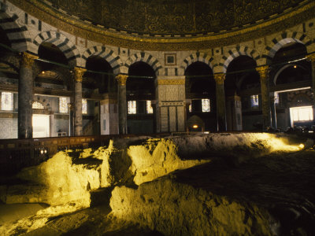
Dome of the Rock/ Al Aqsa Mosque
Interior of The Dome of the Rock

Slide 13
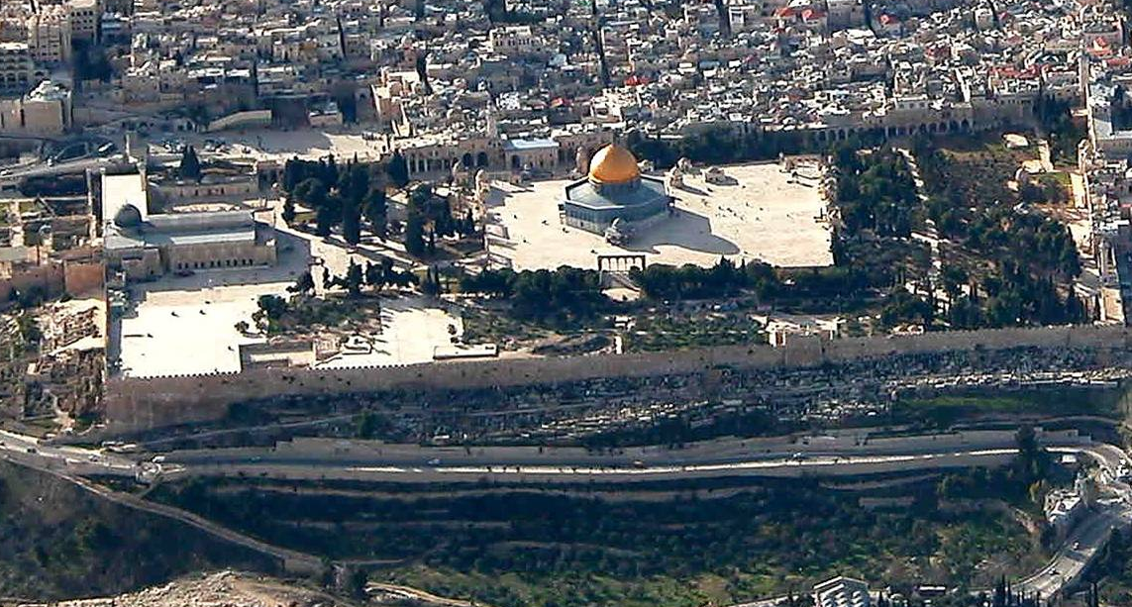
Dome of the Rock/ Al Aqsa Mosque
Al Aqsa Mosque Dome of the Rock

Slide 14
The Hijrah: Flight to Medina
By 622, Muhammad and his followers fled to Medina (then known as Yathrib).
This marks the birth of Islam.
Soon, the whole city are Muslims.
The Meccans tried to kill him.
Wars were fought.
In 630, Muhammad led an army into Mecca and took control of the city. He cleared the idols from the Ka’bah, dedicated it to Allah.
632: dies at age 63.

Slide 15
Beliefs
There is one God, called Allah, the God of Abraham
Jews and Christians received revelations from God through prophets
Muhammad is God’s last prophet.
Believe in a last Judgment very similar to the Christian (and Zoroastrian) idea. i.e God judges and decides Paradise or Hell.
Practice the Five Pillars of Faith to avoid damnation.

Slide 16
Five Pillars of Faith
1. Declaration of Faith: The Shahada
2. Prayer: The Salat
5 times a day facing Mecca
3. Almsgiving:The Zakat
2.5% of salary to charity
4. Fasting: The Sawm
During the lunar month of Ramadan (July 20 – Aug 18 this year).

Slide 17
Five Pillars of Faith
No food, drink, sex, during daylight hours.
5. Pilgrimage to Mecca: The Hajj
If possible, visit at least once.

Slide 18
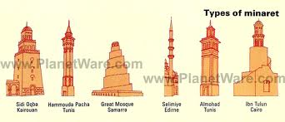
The Mosque
No chairs, no shoes
Friday afternoon is prayer time at Mosque
A Muezzin calls worshippers to prayer from a Mineret ( slender tower).

Slide 19
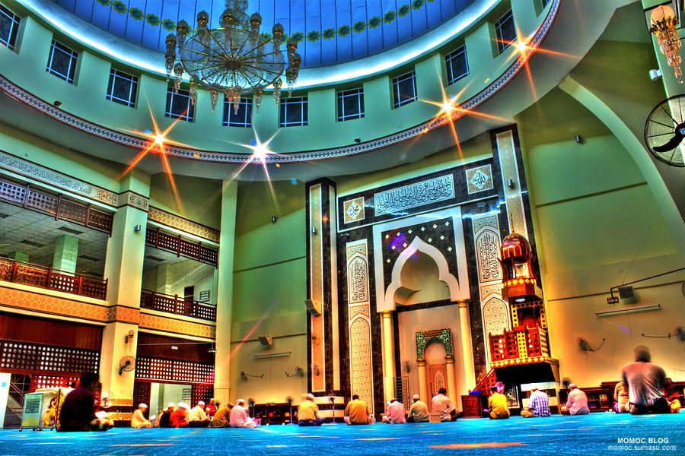
The Mosque

Slide 20
The Mosque
Small niche on one wall called a Mihrab. It points to Mecca.
An Imam leads the prayers. He`s more like a rabbi than a priest.
Running water is needed for ritual purification, the Wudu.

Slide 21
Muslim Symbols
There are no symbols involved in worship.
No pictures, no sculptures.
Stylized verses from the Qur’an decorate the interiors, Arabic calligraphy.

Slide 22
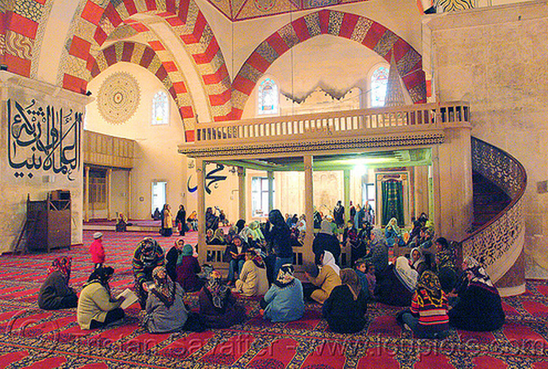
Edirne, Turkey
There are no symbols involved in worship.
No pictures, no sculptures.
Stylized verses from the Qur’an.

Slide 23
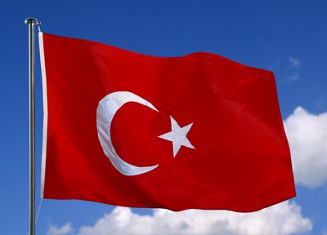
Star and Crescent
On flags of Turkey (and Pakistan)
Crescent moon was originally a Greek symbol of Diana in Byzantium (later Constantinople, now Istanbul).
Star was added by Constantine in 330AD to honour Virgin Mary.

Slide 24
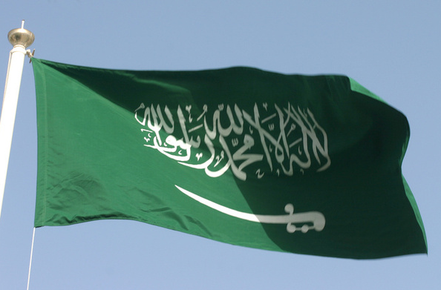
Saudi Flag
Has the Shahadah (declaration of faith) on a Green background (Muhammad’s favourite colour).
And a curved sword.

Slide 25
The Qur’AN
Muslims believe it was dictated to Muhammad by God.
Criticism of Qur’an is considered Blasphemous.
Like the Torah, it can’t be altered.
Only the Arabic Qur’an is considered perfect.
Organized by Surahs (chapters), from longest to shortest.

Slide 26
The Hadith
Sayings attributed to Muhammad
Stories of Muhammad
Clarifies religious practices such as prayers and almsgiving.

Slide 27
Groups
Sunni
85% of all Muslims
Shi’ah
15% of Muslims
Iran and much of Iraq
Sufi (not considered a separate sect)
Mystical
Practice Asceticism and meditating on God.
Whirling Dervishes in Turkey

Slide 28
Expansion of Islam
Within 100 years of Muhammad’s death, Muslims controlled from India to Spain.
During Europe’s “Dark Ages” Islam had its “Golden Age.”
After WWI, European countries dominated them.
Discovery of oil led to resurgence.

Slide 29
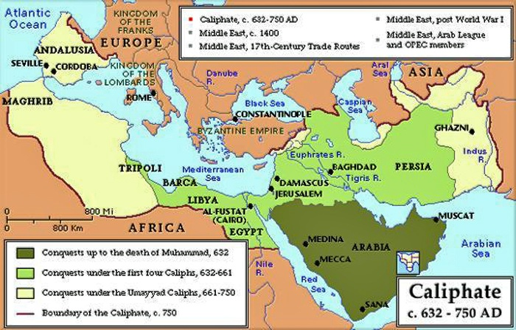
The Islamic Caliphate

Slide 30
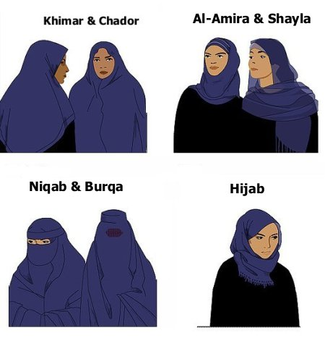
Women in Islam
Standards vary from country to country
Saudi Arabia very repressed
Women in Saudi Arabia 4 minutes

