Slide 1
World Religions 3106 Unit I: Judaism

Slide 2
Founder: Abraham
All Jews trace their genetic and religious ancestry to Abraham, who lived around 1900 B.C.
He lived in Ur, in present day Iraq.
Abraham made a covenant with God, who promised to make of him “a great nation” if he followed God’s commandments.
He journeyed to Canaan, present day Palestine, the “promised land.”
Abraham was the first person in recorded history to worship Yahweh, the all-powerful God worshipped by Jews, Christians and Muslims – 3 billion people.

Slide 3
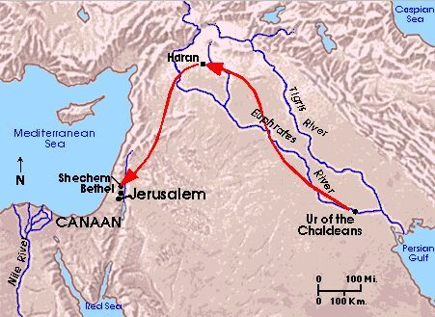
The Journey of Abraham

Slide 4
Central Beliefs
Jews believe that they are the “Chosen People,” since God chose their ancestor Abraham to form his “Covenant” with.
Jews believe that present day Israel is the “Promised Land,” since God promised this land to Abraham and his descendents.

Slide 5
Abraham’s son Isaac
Abraham was the first of the “Patriarchs.”
All Jews trace their ancestry through Abraham’s son Isaac.
All Arabs trace their ancestry through Abraham’s eldest son Ishmael.
The bible says God commanded Abraham to sacrifice his son Isaac, but stopped him just as he was about to slaughter him.

Slide 6
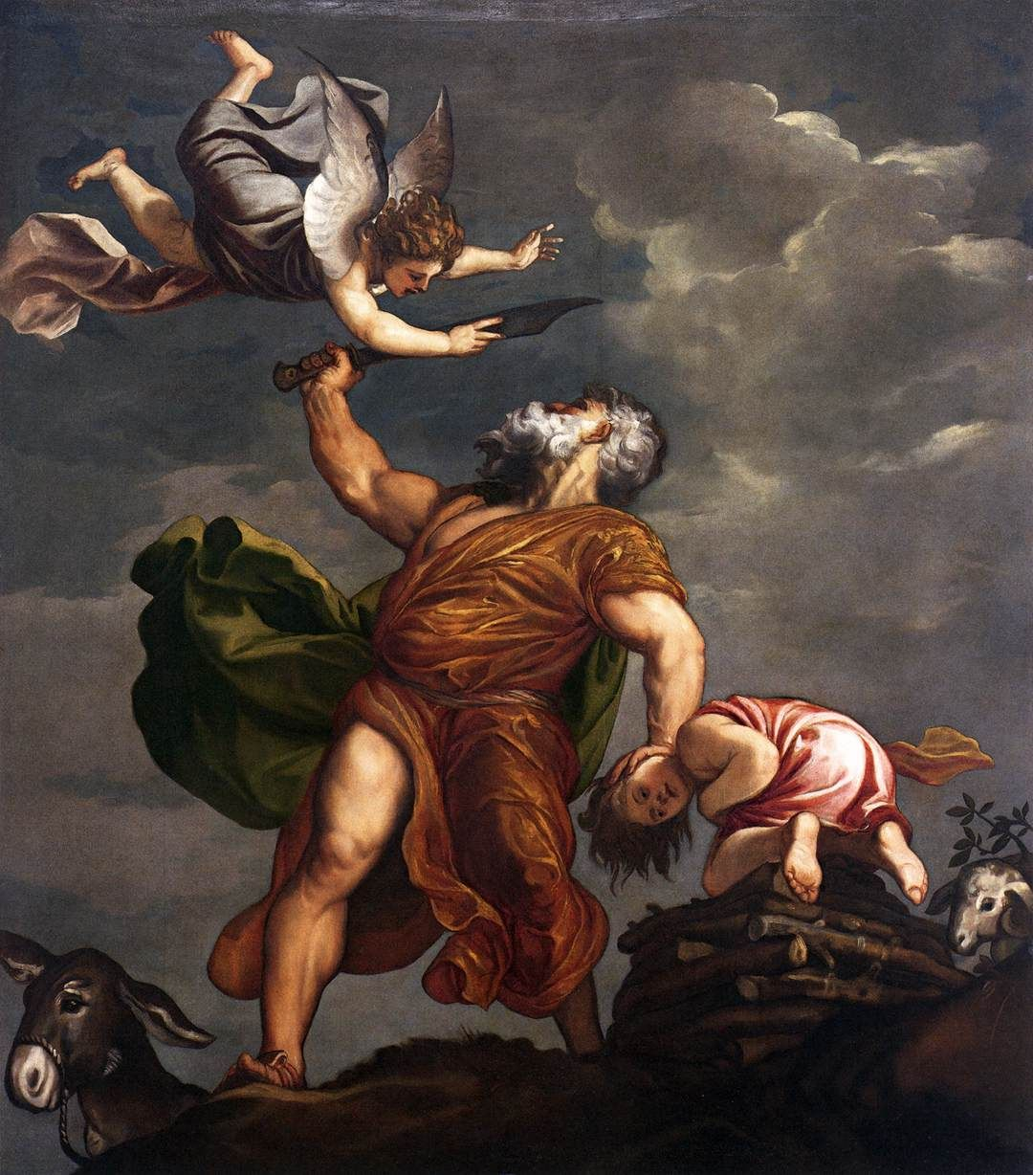
The Sacrifice of Isaac Titian 1542

Slide 7
Isaac’s son Jacob
Isaac had two sons, Jacob and Esau, the eldest.
Jacob was renamed Israel after wrestling with an angel.

Slide 8
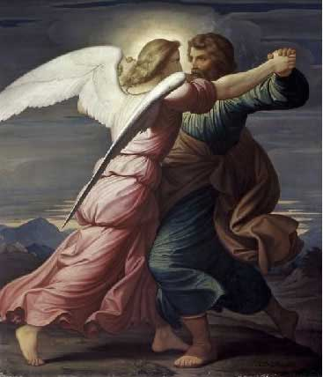
Israel,“One who wrestles with God.”

Slide 9
The Twelve Tribes of Israel
Jacob had 12 sons, who gave rise to the 12 tribes of Israel.
There was a drought in Canaan, and the descendents of Abraham moved to Egypt.
The Hebrew people lived in Egypt for hundreds of years, until the Exodus ~ 1200 B.C.
They were treated as second class citizens, and they wished to leave.

Slide 10
Passover
God inflicts 10 plagues on the Egyptians.
The 10th is the death of every firstborn (son).
Hebrews put lamb’s blood on their lintels (doorposts).
The angel of death “passes over” their homes.
Jews celebrate Passover every spring around Good Friday. (2012: Sundown Friday, April 6th – sundown Saturday, April 14th)
Note: Jesus was arrested and crucified during Passover celebrations in Jerusalem.

Slide 11
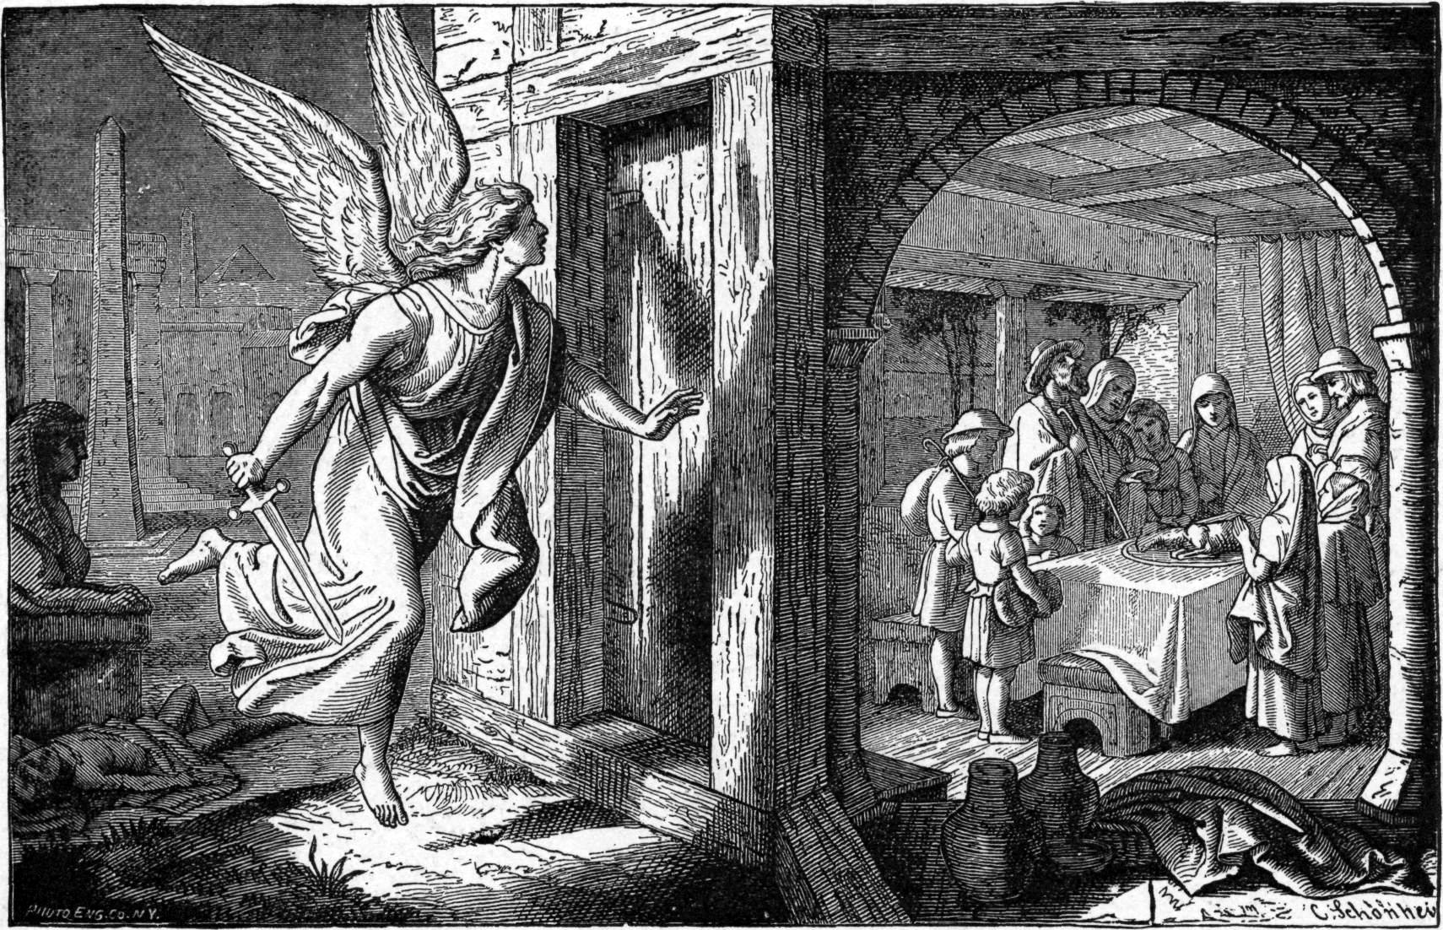
Passover

Slide 12
The Exodus
Moses led the Hebrews out of Egypt ~1200BC.
They crossed the Red Sea and wandered in the desert for 40 years.
Eventually, they conquered the cities of Canaan and established Israel ~ 1000 B.C.

Slide 14
The Ten Commandments
Moses received the Ten Commandments from Yahweh on a mountaintop.
(Side note: He actually received the commandments twice. The first time Moses came down the Israelites were worshipping a golden calf, so he smashed them. Later, he went back.)

Slide 15
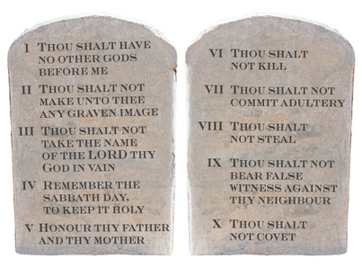
The Ten Commandments

Slide 16
The Kingdom of David
The Israelites eventually conquered all of Canaan. David reigned c. 1000 B.C.
He defeated the Philistines through single combat with their champion Goliath. (Similar to Trojan war)

Slide 17
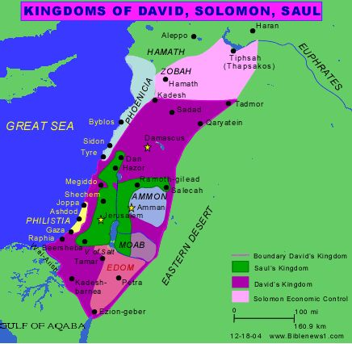
Saul, David and Solomon. United Israel 1050-950 B.C.

Slide 18
The Kingdom Divided
After Solomon, the nation divided. The 10 northern tribes become Israel. The 2 southern tribes become Judah.
It remains like this for 200 years, until Israel is destroyed by Assyria in the 700s B.C.

Slide 19
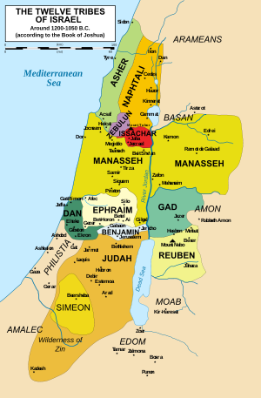
Israel and Judah
Note: The ten northern tribes are the “lost tribes” of Israel, scattered when the Assyrians conquered them (721 B.C.).
Judah survives.

Slide 20
The Babylonian Exile
In 586 B.C. Judah is conquered by the Babylonians. Many are taken to Babylon as captives and slaves. They remain there for 50 years.
In Jerusalem, the 1st temple (Solomon’s temple), the heart of Judaism, is destroyed. Synagogues are born during this time.
During the exile, the Torah (The 5 “Books of Moses” --Genesis, Exodus, Leviticus and Numbers), is written down in its present form.
Jews wait for a “Messiah” to deliver them from captivity.

Slide 21
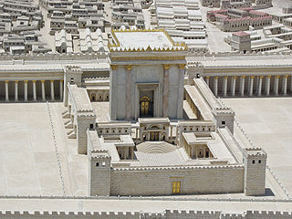
The Second Temple
The Persians allowed Jews to return to Jerusalem and rebuild the temple. The Ark of the Covenant is kept in the Holy of Holies.

Slide 22
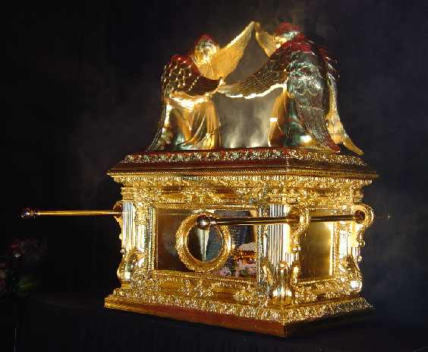
The Ark of the Covenant
Inside:
The stone tablets given to Moses, manna from the exodus, and Aaron’s rod.

Slide 23
Greek conquest
In 332 B.C. Alexander the Great conquer Judah, bringing “Hellenization” (Greek learning and customs).
Jews settle throughout the Mediterranean beginning the “Diaspora.”
The Maccabbees overthrow the Greek rulers in 164 B.C. The story of “Hannukah” celebrates this event.

Slide 24
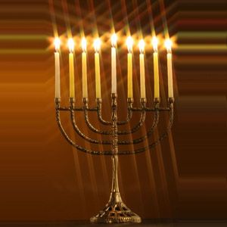
Hannukah: The 9 pointed Menorah
8 candles celebrate the 8 nights after the temple was liberated by the Maccabbees. (There was only enough oil for one night!)
Dec. 08—16 2012.

Slide 25
Roman Conquest
64 B.C. Jews lose their independence again.
Jews pray for a “Messiah” to free them from Roman rule. (Yeshua of Nazareth is crucified c. 29.A.D.)
In 66 A.D. full scale rebellion against Rome.
In 70.A.D., the rebellion is crushed, the temple is destroyed, Jerusalem is sacked, Jews are marched into Rome as slaves.
With no more temple sacrifice, Judaism becomes focused on “Synagogues” and “Rabbis.”

Slide 26
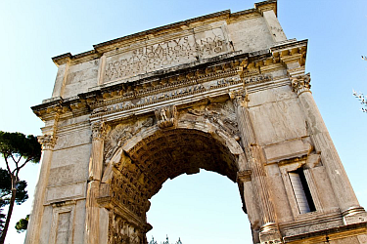
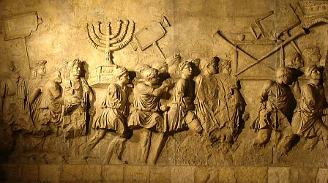
The Arch of Titus
Roman “Arch of Titus” showing the temple treasure and Jewish captives.

