Slide 1
Beliefs about God
The universe is governed by God.
God is indivisible.
Not a physical being.
The bible calls God, YHWH (“I am”).
a.k.a. The Lord (“Adonay”)

Slide 2
The Torah
Contained in a Holy Ark.
Usually 2 or 3 in a synagogue
Written on parchment scrolls.
Cannot be touched.
Taken out during services and read.
Divided into 54 sections. One section is read each week for the year.

Slide 3
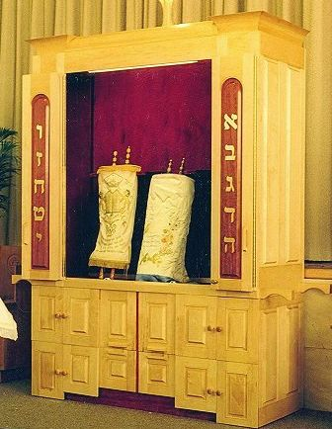
The Torah
Ark doors opened.

Slide 4
Rabbis
A trained scholar, teacher, interpreter of Jewish law, councillor. [Jesus was called Rabbi by his followers.]
Conduct services like Bar Mitzvahs, weddings, and funerals.

Slide 5
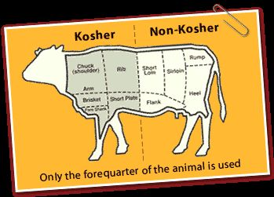
Keeping Kosher: Kashruth
Foods must be prepared according to a set of rules.
Out: Pork, rabbit, eagle, owl, catfish, sturgeon, and any shellfish, insect or reptile are non-kosher.
Strangled meats are non-kosher.

Slide 6
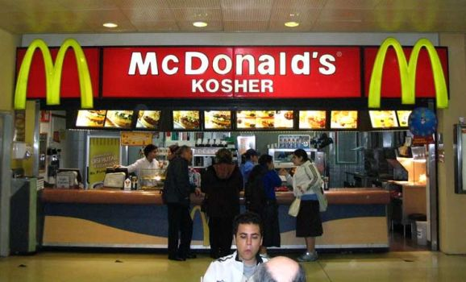
Keeping Kosher

Slide 7
Shabbat
Sunset Friday to Sunset Saturday
Go to Synagogue for Friday prayers
Candles lit to remember creation
Shabbas: Sabbath meal
Kiddush: Prayer over the wine
Challah: Egg bread
Shabbat Meal in Israel Shabbat meal in Israel

Slide 8
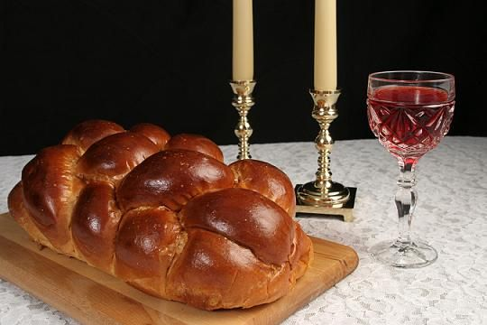
Wine and Challah

Slide 9
Jewish Festivals: Rosh Hashanah:
Jewish New Year
Occurs around the Autumn Equinox
Ten day period of repentence.
Ends with Yom Kippur: The Day of Atonement
The Shofar is sounded.
How to Blow the Shofar
How to celebrate Rosh Hashanah
CBN The Feast of The New Year 700 Club

Slide 10
Jewish Festivals: Yom Kippur
Holiest day in the Jewish Year. Fasting, prayers, abstinence. Day of Atonement for sins.
Temple sanctuary when Hebrews were still a wandering people 1250-1050 BCE
950 BCE-70CE: The High Priest used to enter the Holy of Holies on this day to pray for the sins of the Israelites.
Animals were sacrificed for the sins of the people.

Slide 11
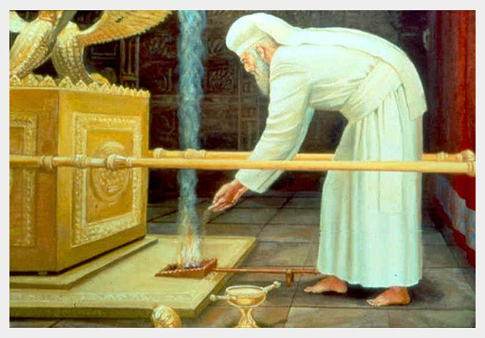
The Kohen Badol on Yom Kippur

Slide 12
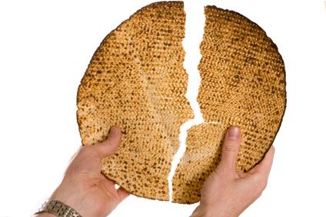
Pesach/Passover: Matzoh
Celebrates the Exodus.
No leavened food for a week.
Eldest son should fast on the first day
The Sedar:
Ritual service and dinner held at home on first night of Passover.

Slide 13
Passover Seder
Events of the Exodus are retold.
Learning about Passover with Rabbi Akselrad

Slide 14
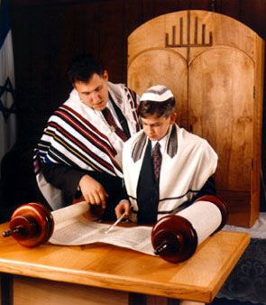
Bar/Bat Mitzvah
Coming of age ceremony at 13.
Noam’s Bar Mitzvah.
Bat Mitzvah at Boston Temple.

Slide 15
Weddings
Take place under a canopy called a Chuppah.
Drink from a glass of wine
Crush a glass under foot
Orthodox Jewish wedding Brooklyn NY 2005

Slide 16
Death
Cremation is not allowed
Burial within 24 hours if possible (like Islam)
Shiva: a seven period of mourning.
Mourners stay at home.
Mirrors are covered.
How to sit Shiva

Slide 17
Types of Judaism
Orthodox/ Hasidic
Reform
Conservative
Reconstructionist

Slide 18
Zionism
Return of Jews to the Promised Land
Began in 1896 with Theodore Herzl
After the Holocaust, the state of Israel was declared in 1948
Conflict has been ongoing. . .

