Slide 1
The History of Christmas Music
Experiencing Music

Slide 2
What is a Christmas Carol?
A song with religious background, or at least that has been performed by church and amateur choirs frequently
It should have a rapid, regular beat
In some countries it is considered bad luck to sing Christmas Carols before December 1st or after Christmas Day!

Slide 3
Origins
Christmas Carols have existed in Europe in various forms since the fourth century
The gained popularity after reformation in the countries where Protestant churches gained popularity
Adeste Fidelis (O Come All Ye Faithful) first appeared in its current form in the 18th century though it seems the words came about in the 13th century

Slide 4
Origins continued
God Rest Ye Merry, Gentleman; The First Noel and Hark the Herald Angels Sing are all Christmas Carols that first appeared in Christmas Carols Ancient and Modern (1833)
Many new carols were written during this same time period
Today, carols are frequently sung at Christian Religious services

Slide 5
Carols Around the World
While each country has it’s own popular Christmas Carols, there are some that have become popular over the world
Each country also has it’s own Christmas traditions
Let’s take a world tour of Christmas Carols!

Slide 6
Germany and Austria
Silent Night was written by Austrians Franz Gruber and Joseph Mohr
O Christmas Tree is a German folksong that became popular after it was arranged by Ernst Anschütz
Still, Still, Still is a folksong from the Salzburg area of Austria

Slide 7
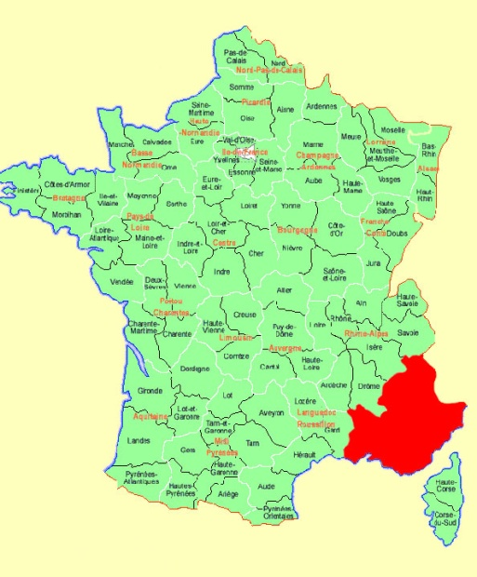
France
O Holy Night is an English adaptation of Cantique de Noël, a 19th century tradition French carol
Il est né, le divin Enfant is the most popular French carol. It originates from the region of Provence

Slide 8
Greece and Cyprus
In this part of the world popular Christmas carols vary be region
The oldest known carol is Byzantine Carol (God Who Has No Beginning Descended)
Kalanta Xristougenna is another popular Greek carol
In the older times caroling asked for and were given gifts such as dried fruit, nuts, eggs and sweets

Slide 9
Ukraine
Basically all Ukraine carols (some of which are centuries old) are associated with the birth of Jesus Christ
The most famous Ukraine Carol is Carol of the Bells. It was premiered in December of 1916 by the choir of students from Kiev University

Slide 10
What is a Christmas Song?
It is sometimes hard to distinguish the difference between a Christmas Carol and a Christmas Song
Christmas Songs have less of a religious nature, are not often sung in Church
Christmas Songs are performed more often by artists and not the public
They are more complicated, lacking regular form and beat

Slide 11
Christmas Songs on Radio
Radio stations are responsible for most of the broadcasting, popularization and appreciation of Christmas songs
Each year the playing of Christmas songs starts earlier. It is believed this helps put people in the Christmas spirit, ensuring they start their shopping, creating a major economy boost

Slide 12
400 radio stations across the United States play Christmas music around the clock during the holidays
With the music industry making 40% of it’s revenue during the 3 months leading up to Christmas, many artists are releasing Christmas songs to keep with the season and to help promote themselves

Slide 13
Popular Christmas Songs
In addition to radio, popular Christmas songs are frequently introduced through film
The first example of this was ‘White Christmas’ which was first released in 1942
Many songs have been adopted Christmas songs. They are not specifically about Christmas but the content is often associated with the season

Slide 14
Ten Most Played Christmas Songs
10) Rudolph the Red-Nosed Reindeer
9) Sleigh Ride
8) The Little Drummer Boy
7) Jingle Bell Rock
6) Let it Snow! Let it Snow! Let it Snow!
5) White Christmas
4) Santa Claus is Coming to Town
3) Winter Wonderland
2) Have Yourself a Merry Little Christmas

Slide 15
1.
The Christmas Song

Slide 16
Novelty Songs
A sub-category of the Christmas Song is the novelty song
These are performed solely for comical effect
They are often geared more towards either kids or adults

Slide 17
Kids Novelty Songs
I Saw Mommy Kissing Santa Claus
All I Want for Christmas is my Two Front Teeth
Nuttin’ for Christmas
I Want a Hippopotamus for Christmas
The Chipmunk Song
Snoopy’s Christmas

Slide 18
Adult Novelty Songs
Grandma Got Run Over By A Reindeer
Rusty Chevrolet
Christmas Tree (Lady Gaga)
12 Days of Christmas (Straight No Chaser)

