Slide 1
MUSIC IN POLITICAL AND SOCIAL MOVEMENTS
PROTEST SONGS
Experiencing Music 2200

Slide 2
What will you learn?
What protest music is all about!
About the role of music in carrying the message of social and political movements all over the world
About how music has been used to communicate environmental concerns
How to analyze lyrics and music of protest songs

Slide 3
Evaluation for this Unit
Unit Test
Project (you will be given options to choose from)
Listening/Participation
Journal

Slide 4
Protest and Peace
Can you think of any musicians that stand out and speak up for what they believe in?
Is there a performer whose music speaks out about the problems you and your peers face?
People turn to music often to express their views about the concerns and struggles of their time
In this unit, we will meet performers whose works have reshaped the views and actions of society

Slide 5
What is protest music?
Protest music is music that expresses an opinion or concerns about problems
These problems are most commonly world issues
Many protest songs talk about war, peace, prolife/prochoice, sexual orientation, etc
Protest music is defined as a powerful musical genre directed at social injustices and the desire for change

Slide 6
Where does protest music come from?
Protest songs came out of folk music
Folk music is defined as uncomplicated music that speaks directly to everyday matters
Folk music tells storys through simple verse/chorus style music
Before the Beatles became popular, folk music was probably the most popular style of music

Slide 7
We Shall Overcome
Arguably, the most recognized protest song of the Civil Rights era is called “We Shall Overcome”.
The song is about the struggle for freedom and was originally sung by enslaved Africans in America
In the 1940’s, African American textile workers modified the lyrics to ‘I Shall Overcome’ and the song took on new meaning about the labor struggle in America
The song is said to have set America marching toward racial equality
“Blowin’ in the Wind” by Bob Dylan, is another song with a similar meaning

Slide 8
We Shall Overcome
We shall overcome, We shall overcome, We shall overcome, some day. Oh, deep in my heart, I do believe We shall overcome, some day. We’ll walk hand in hand, We’ll walk hand in hand, We’ll walk hand in hand, some day. Oh, deep in my heart, We shall live in peace, We shall live in peace, We shall live in peace, some day. Oh, deep in my heart, We shall all be free, We shall all be free, We shall all be free, some day. Oh, deep in my heart,
We are not afraid, We are not afraid, We are not afraid, TODAY Oh, deep in my heart, We shall overcome, We shall overcome, We shall overcome, some day. Oh, deep in my heart, I do believe
We Shall overcome someday
http://www.youtube.com/watch?v=NLlBTnfRkTg&feature=related&safety_mode=true&persist_safety_mode=1
Bruce Springsteen singing We Shall Overcome

Slide 9
What happened with the civil rights movement?
In 1964, the United States Congress signed the Civil Rights Act which made it illegal to discriminate against people on the basis of race or colour. The songs of the protestors finally reached the ears of the government.
This day is now commemorated as Martin Luther King day in the USA.

Slide 10
Protests War/Promoting Peace
Thousands of protest songs are written about war and/or peace
Bob Dylan and John Lennon were two of the frontmen for the promotion of peace and protest of war
The Vietnam war went on during the 1960’s and 1970’s and affected the whole world. It was also the first war to ever be televised.
The Vietnam war occurred during the same time period as the Civil Rights Movement so music during this time was filled with messages about war, peace and equality.

Slide 11
Bob Dylan
Bob Dylan’s ‘Blowin’ in the Wind’, thought originally written about the Civil Rights Movement, also became a hugely popular anti-war anthem
Dylan also wrote many more anti-war songs
During his prime, Dylan was popular with the youth but many adults scorned him.
Most adults not only scorned him because of his music, but because of his appearance-alternative dress, long hair, an overall ‘hippie’ look.

Slide 12
Bob Dylan’s Blowin in the Wind
How many roads most a man walk down Before you call him a man ? How many seas must a white dove sail Before she sleeps in the sand ? Yes, how many times must the cannon balls fly Before they're forever banned ? The answer my friend is blowin' in the wind The answer is blowin' in the wind. Yes, how many years can a mountain exist Before it's washed to the sea ? Yes, how many years can some people exist Before they're allowed to be free ? Yes, how many times can a man turn his head Pretending he just doesn't see ? The answer my friend is blowin' in the wind The answer is blowin' in the wind.
Yes, how many times must a man look up Before he can see the sky ? Yes, how many ears must one man have Before he can hear people cry ? Yes, how many deaths will it take till he knows That too many people have died ? The answer my friend is blowin' in the wind The answer is blowin' in the wind.
http://www.youtube.com/watch?v=jgFz3tZYg-M&safety_mode=true&persist_safety_mode=1

Slide 13
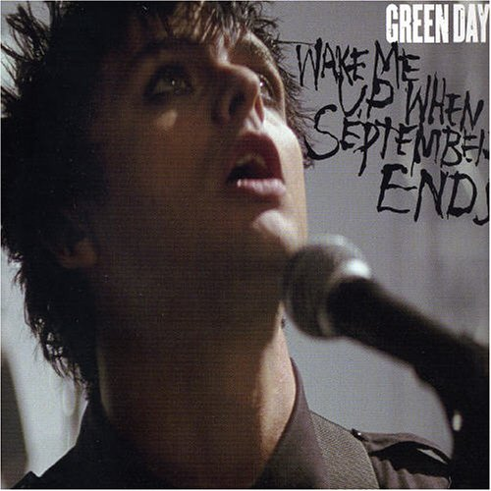
Wake Me Up When September Ends
Summer has come and passed The innocent can never last wake me up when September ends like my father's come to pass seven years has gone so fast wake me up when September ends here comes the rain again falling from the stars drenched in my pain again becoming who we are as my memory rests but never forgets what I lost wake me up when September ends summer has come and passed the innocent can never last wake me up when September ends
ring out the bells again like we did when spring began wake me up when September ends here comes the rain again falling from the stars drenched in my pain again becoming who we are as my memory rests but never forgets what I lost wake me up when September ends Summer has come and passed The innocent can never last wake me up when September ends like my father's come to pass twenty years has gone so fast wake me up when September ends wake me up when September ends wake me up when September ends

Slide 14
Meaning?
There was once much debate regarding the meaning of this song, one of the most common initial beliefs being that it was about the events of 9/11. In the liner notes, the song is dated September 10, and it is track 11 on the album. However, Billie Joe Armstrong has clarified that the song was written as a memorial to his father, a jazz musician and truck driver, who died of esophageal cancer in 1982 when Armstrong was only 10 years old.In the live DVD, Billie Joe started crying during the performance of the song. Billie stated, "I tried to fight it, but singing that song on stage and having 60,000 people singing it right back at you, it was just too overwhelming.“
(http://en.wikipedia.org/wiki/Wake_Me_Up_When_September_Ends)

Slide 15
Environmental Protest Songs
Many songs are written in protest of pollution and industrialization
Industrialization is the taking over of land. Companies take over land to put business, buildings and houses on it, ruining the environment.
Some bands who are known for writing songs about the environment are 30 Seconds to Mars, Daughtry, Ani DiFranco and the Counting Crows.

Slide 16
Beautiful Lie
30 Seconds to Mars: Beautiful Lie, shows stunning pictures of the arctic and encourages people to stand up and do something about global warming. http://www.youtube.com/watch?v=4Kvd-uquuhI&safety_mode=true&persist_safety_mode=1

Slide 17
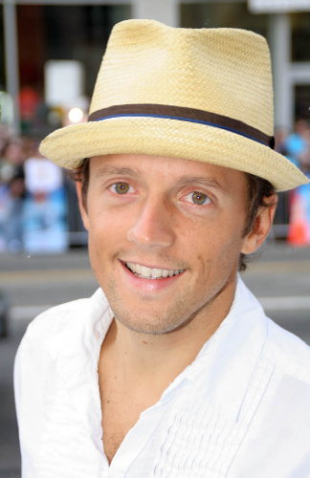
Jason Mraz ‘Only Human’
This song is a social commentary about the environment and industrialization.
The song is also said, by Mraz himself, to be about a tree in his backyard.
http://www.youtube.com/watch?v=uXKpFnGz4ck&safety_mode=true&persist_safety_mode=1

Slide 18
Only Human
Up in the major’s tree, the one he planted back when he was just a boy Thinking 1923 Thirty meters and a foot, take a look, take a climb What you’ll find is the product of a seed The seed is sown, all alone It grows above, with a heart of love Sharp and shelter of the animals of land and cold weather breathing We’re all breathing in The planet’s talking about a revolution The natural laws ain’t got no constitution They’ve got a right to live their own life But we keep paving over paradise ‘Cause we’re only human Yes we are, only human If it’s our only excuse do you think we’ll keep on being only human Yes we are, only human, only human, so far, so far And this place it will outlive me Before I get to heaven I’ll climb that tree And I will have to give my thanks For giving me the branch to swing on If I ever fall in love I’ll have to give myself a baby I will let my children have their way ‘Cause we’re only human, yes we are Only human, so far, so far
A squirrel in the tree is he watching me Does he give a damn? Does he care who I am? I’m just a man, is that all I am Are my manners misinterpreted words or only human? I’m human Murderous crow, hey what you know What you reading about, what you hold in your toes Is that a twig, are you a dove of peace A black dove undercover, with another puzzle piece Are you a riddle to solve all along? Or am I over thinking thoughts of human after all Only human Made of flesh, made of sand, made of you and me The planet’s talking about a revolution The natural laws ain’t got no constitution They’ve got a right to live their own life But we keep paving over paradise ‘Cause we’re only human Yes we are, only human If it’s our only excuse do you think we’ll keep on being only human Yes we are, yes we are Only human, only human, only human So far…

Slide 19
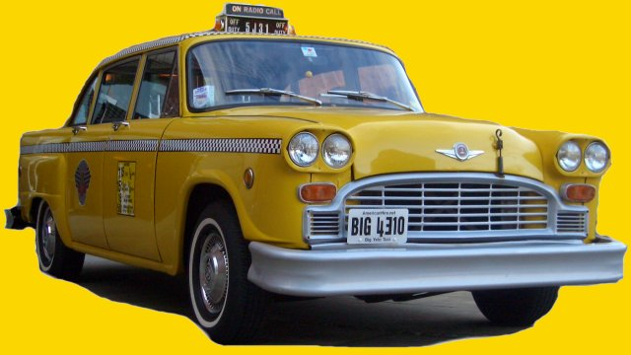
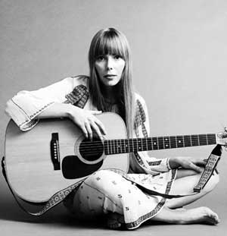
Joni Mitchelle ‘Big Yellow Taxi’
Though covered by the Counting Crows, this song was originally written by Canada’s Joni Mitchell.
The song specifically talks about industrialization and ‘paving paradise for a parking lot’.
What are the similarities between this song and Jason Mraz’s Only Human.

Slide 20
Big Yellow Taxi
Listen, late last night, I heard the screen door swing, And a big yellow taxi took my girl away Now don't it always seem to go That you don't know what you got till it's gone They paved paradise and put up a parking lot Hey now now, don't it always seem to go That you don't know what you got till it's gone They paved paradise to put up a parking lot Why not, they paved paradise They put up a parking lot Hey hey hey, paved paradise and put up a parking lot I don't wanna give it Why you wanna give it Why you wanna givin it all away Hey, hey, hey Now you wanna give it I should wanna give it Cuz you're givin it all away, no no I don't wanna give it Why you wanna give it Why you wanna givin it all away Cuz you're givin it all givin it all away yeah yeah Cuz You're givin it all away hey, hey, hey Hey, paved paradise, to put up a parking lot
They paved paradise and put up a parkin' lot With a pink hotel, a boutique, and a swingin' hot spot Don't it always seem to go That you don't know what you got till it's gone They paved paradise and put up a parkin' lot They took all the trees, and put em in a tree museum And they charged the people a dollar and a half to see them No, no, no, don't it always seem to go That you don't know what you've got till it's gone They paved paradise, and put up a parkin' lot Hey farmer, farmer, put away your DDT I don't care about spots on my apples, Leave me the birds and the bees - please Don't it always seem to go That you don't know what you got till it's gone They paved paradise and put up a parking lot Hey now, they've paved paradise to put up a parking lot Why not?
http://www.youtube.com/watch?v=tvtJPs8IDgU&safety_mode=true&persist_safety_mode=1

Slide 21
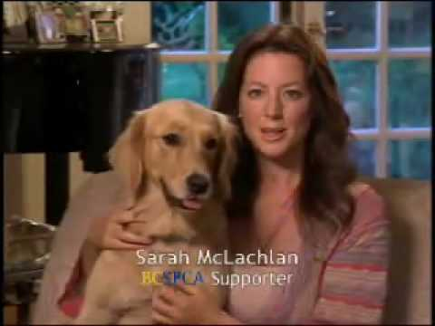
Protest Songs About Animal Abuse
Many musicians have also taken up a platform about animal abuse.
A platform is an issue or concern that a musician or person is particularly interested in and protests or promotes often.
Sarah McLachlan is a Canadian singer-songwriter who frequently protests animal cruelty and promotes animal protection.

Slide 22
Protest Songs About Racism
Hundreds of musicians have written songs about the issue of Racism.
James Brown was one of the first and came out with a song called ‘Say it Loud, I’m Black and Proud’. http://www.youtube.com/watch?v=CisfU6vkLvo&safety_mode=true&persist_safety_mode=1
Public Enemy’s ‘Fight the Power’ was also a popular protest song. http://www.youtube.com/watch?v=8PaoLy7PHwk&safety_mode=true&persist_safety_mode=1
There are also many movies out on the issue such as The Debaters and Hairspray.

Slide 23
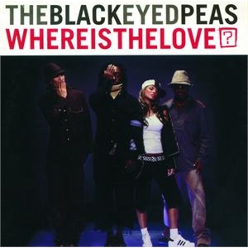
Black Eyed Peas ‘Where is the Love?’
People killing people dying Children hurtin you hear them crying Can you practice what you preach Would you turn the other cheek? Father Father Father help us Send some guidance from above Cause people got me got me questioning Where is the love?
http://www.youtube.com/watch?v=WpYeekQkAdc&safety_mode=true&persist_safety_mode=1

Slide 24
Garth Brooks ‘We Shall Be Free’
This ain't comin' from no prophet Just an ordinary man When I close my eyes I see The way this world shall be When we all walk hand in hand When the last child cries for a crust of bread When the last man dies for just words that he said When there's shelter over the poorest head We shall be free When the last thing we notice is the color of skin And the first thing we look for is the beauty within When the skies and the oceans are clean again Then we shall be free We shall be free We shall be free Stand straight, walk proud 'Cause we shall be free When we're free to love anyone we choose When this world's big enough for all different views When we all can worship from our own kind of pew Then we shall be free We shall be free
http://video.google.com/videoplay?docid=1419784736758648402#
We shall be free Have a little faith Hold out 'Cause we shall be free And when money talks for the very last time And nobody walks a step behind When there's only one race and that's mankind Then we shall be free We shall be free We shall be free Stand straight, walk proud, have a little faith, hold out We shall be free We shall be free We shall be free Stand straight, have a little faith We shall be free

Slide 25
Pollution: Tom Lehrer
Some protest songs might also include satire.
Satire is a “literary technique of writing or art which principally ridicules its subject often as an intended means of provoking or preventing change. Humour is often used to aid this.” (en.wiktionary.org/wiki/satire )
Tom Lehrer’s song ‘Pollution’ talks about how America is polluted and it is affecting the health of its people.
The lyrics for his song are written in a funny manner to catch the attention of the viewer/listener. It is also very catchy!
http://www.youtube.com/watch?v=r1WiAA2QW6E&safety_mode=true&persist_safety_mode=1

Slide 26
Concrete Angel: A Protest Song About Child Abuse
Concrete Angel by Martina McBride is clearly a song about child abuse.
In the song, she talks about a girl who has to hide her bruises and scratches when she goes to school
The words ‘Concrete Angel’ serve as a metaphor, meaning that this girl can take so much pain she is almost like concrete and she is an angel for not reacting with anger and violence.
http://www.youtube.com/watch?v=KtNYA4pAGjI&safety_mode=true&persist_safety_mode=1

Slide 27
The neigbors hear, but they turn out the lights A fragile soul caught in the hands of fate When morning comes, it'll be too late Through the wind and the rain She stands hard as a stone In a world that she can't rise above But her dreams give her wings And she flies to a place Where she's loved Concrete Angel A statue stands in a shaded place An angel girl with an upturned face A name is written on a polished rock A broken heart that the world forgot Through the wind and the rain She stands hard as a stone In a world that she can't rise above But her dreams give her wings And she flies to a place Where she's loved Concrete Angel
She walks to school with the lunch she packed Nobody knows what she's holding back Wearing the same dress she wore yesterday, she hides the bruises with linen and lace Oooh The teacher wonders, but she doesn't ask It's hard to see the pain behind the mask Bearing the burden of a secret storm Sometimes she wishes she was never born Somebody cries in the middle of the night
Through the wind and the rain She stands hard as a stone In a world that she can't rise above But her dreams give her wings And she flies to a place Where she's loved Concrete Angel

Slide 28
Protest Songs About Domestic Abuse
Some songs are written about domestic violence.
Domestic violence is violence in a relationship. It can include physical or mental abuse.
Tracy Chapman’s ‘Behind the Wall’ talks about the unfortunate events that occur during domestic abuse.
Why is this song sung acappella (with no music)?
http://www.youtube.com/watch?v=1iUoqTaowaI&safety_mode=true&persist_safety_mode=1

Slide 29
Last night I heard the screaming Loud voices behind the wall Another sleepless night for me It won't do no good to call The police Always come late If they come at all Last night I heard the screaming Loud voices behind the wall Another sleepless night for me It won't do no good to call The police Always come late If they come at all And when they arrive They say they can't interfear With domestic affairs Between a man and his wife And as they walk out the door The tears well up in her eyes
Last night I heard the screaming Then a silence that chilled my soul Prayed that I was dreaming When I saw the ambulance in the road And the policeman said "I'm here to keep the peace. Will the crowd disperse? I think we all could use some sleep." Last night I heard the screaming Loud voices behind the wall Another sleepless night for me It won't do no good to call The police Always come late If they come at all

Slide 30
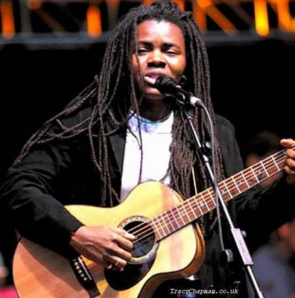

Slide 31
I’m Okay – Christina Aguilera
Christina Aguilera’s song takes the viewpoint of a child growing up in a abusive environment.
The child is watching her father abuse her mother and the song talks about the child’s views on what is going on.
http://www.youtube.com/watch?v=quAFmNvk_Zs&safety_mode=true&persist_safety_mode=1

Slide 33
Bob Marley - War
Bob Marley uses the upbeat genre of reggae to promote a message of peace.
Reggae was first developed in Jamaica in the late 1960s. Reggae music usually utilizes the off beat and is very catchy and upbeat.
Bob Marley’s song war talks about the world’s need to stop war and live together in peace.
http://www.youtube.com/watch?v=I9CG2iE2vxU&safety_mode=true&persist_safety_mode=1

Slide 34
And until the ignoble and unhappy regimes that hold our brothers in Angola, In Mozambique, South Africa Sub-human bondage Have been toppled, Utterly destroyed - Well, everywhere is war - Me say war.
War in the east, War in the west, War up north, War down south - War - war - Rumours of war. And until that day, The African continent Will not know peace, We Africans will fight - we find it necessary - And we know we shall win As we are confident In the victory
Of good over evil - Good over evil, yeah! Good over evil - Good over evil, yeah! Good over evil - Good over evil, yeah! [fadeout]
Until the philosophy which hold one race superior And another Inferior Is finally And permanently Discredited And abandoned - Everywhere is war - Me say war.
That until there no longer First class and second class citizens of any nation Until the colour of a man's skin Is of no more significance than the colour of his eyes - Me say war.
That until the basic human rights Are equally guaranteed to all, Without regard to race - Dis a war.
That until that day The dream of lasting peace, World citizenship Rule of international morality Will remain in but a fleeting illusion to be pursued, But never attained - Now everywhere is war - war.

Slide 35
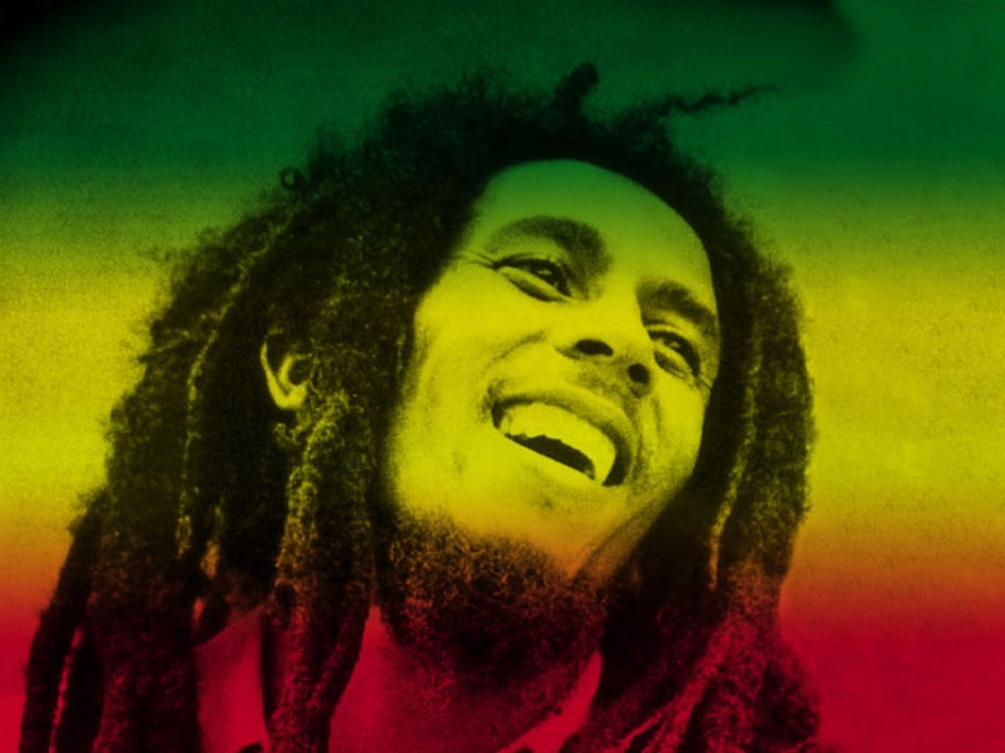

Slide 36
Dixie Chicks – Not Ready to Make Nice
This protest song was written after the singer for the Dixie Chicks, Natalie Maine, said that she was ashamed the President of the United States was from Texas.
Since country music is usually associated with conservative government, there was total outrage after she said this.
Many people stopped listening to their music, burned their CDs, stopped going to their concerts and even stopped playing their music on country radio.
Since country stations didn’t want to play their music, they decided to write ‘Not Ready to Make Nice’ which is a more “pop” sounding protest song.
The video for this song is very powerful, what about the video reflects the message in the music?
http://www.youtube.com/watch?v=rDazrN4WcqQ&feature=related&safety_mode=true&persist_safety_mode=1

Slide 37
And how in the world can the words that I said Send somebody so over the edge That they'd write me a letter Sayin' that I better shut up and sing Or my life will be over I'm not ready to make nice I'm not ready to back down I'm still mad as hell and I don't have time to go round and round and round It's too late to make it right I probably wouldn't if I could 'Cause I'm mad as hell Can't bring myself to do what it is you think I should I'm not ready to make nice I'm not ready to back down I'm still mad as hell and I don't have time to go round and round and round It's too late to make it right I probably wouldn't if I could 'Cause I'm mad as hell Can't bring myself to do what it is you think I should Forgive, sounds good Forget, I'm not sure I could They say time heals everything But I'm still waiting
Forgive, sounds good Forget, I'm not sure I could They say time heals everything But I'm still waiting I'm through with doubt There's nothing left for me to figure out I've paid a price And I'll keep paying I'm not ready to make nice I'm not ready to back down I'm still mad as hell and I don't have time to go round and round and round It's too late to make it right I probably wouldn't if I could 'Cause I'm mad as hell Can't bring myself to do what it is you think I should I know you said Can't you just get over it It turned my whole world around And I kind of like it I made my bed and I sleep like a baby With no regrets and I don't mind sayin' It's a sad sad story when a mother will teach her Daughter that she ought to hate a perfect stranger

Slide 38
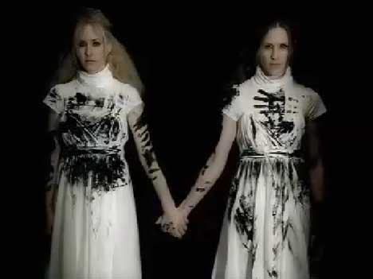

Slide 39
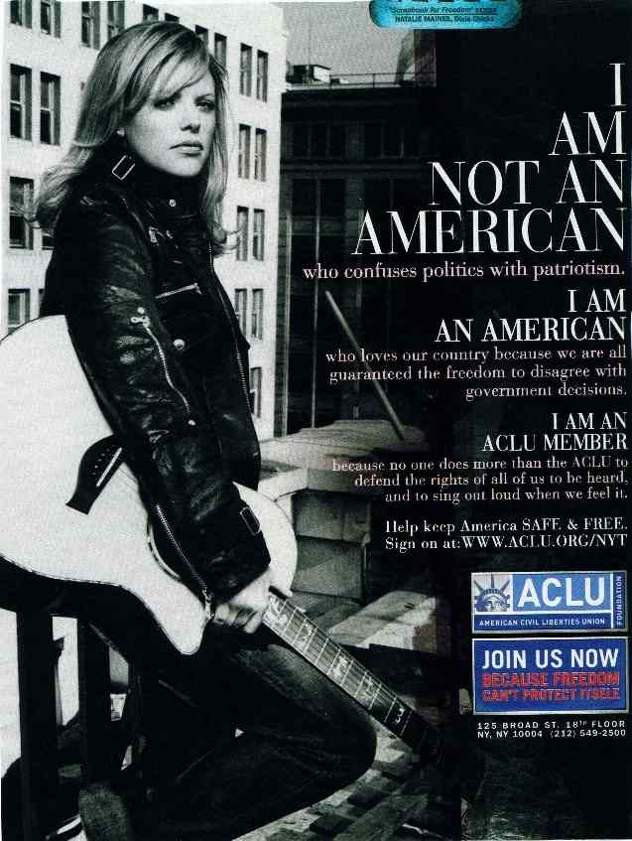

Slide 40
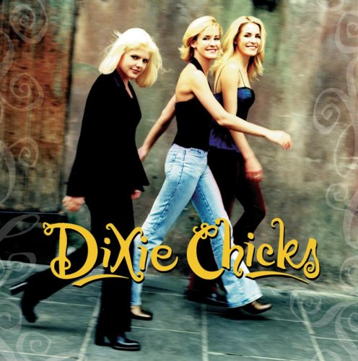

Slide 41
Imagine- John Lennon
John Lennon’s ‘Imagine’ is probably the world’s most well-known protest song.
In the song, Lennon imagines what it would be like to have a peaceful world where there was no war, racism and no boundaries to separate our countries.
Imagine has been covered several times by many different artists.
http://www.youtube.com/watch?v=2xB4dbdNSXY&safety_mode=true&persist_safety_mode=1

Slide 42
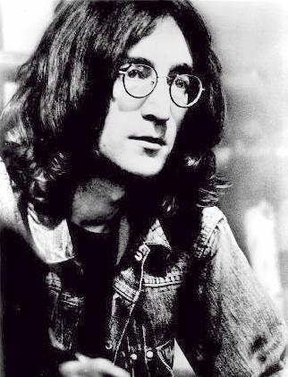
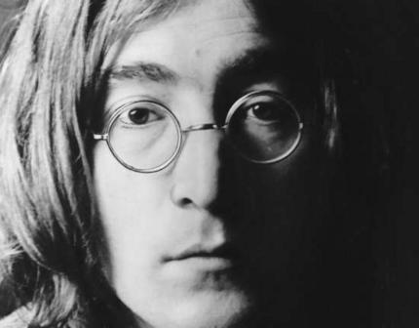
Imagine there's no Heaven It's easy if you try No hell below us Above us only sky Imagine all the people Living for today Imagine there's no countries It isn't hard to do Nothing to kill or die for And no religion too Imagine all the people Living life in peace You may say that I'm a dreamer But I'm not the only one I hope someday you'll join us And the world will be as one Imagine no possessions I wonder if you can No need for greed or hunger A brotherhood of man Imagine all the people Sharing all the world You may say that I'm a dreamer But I'm not the only one I hope someday you'll join us And the world will live as one

Slide 43
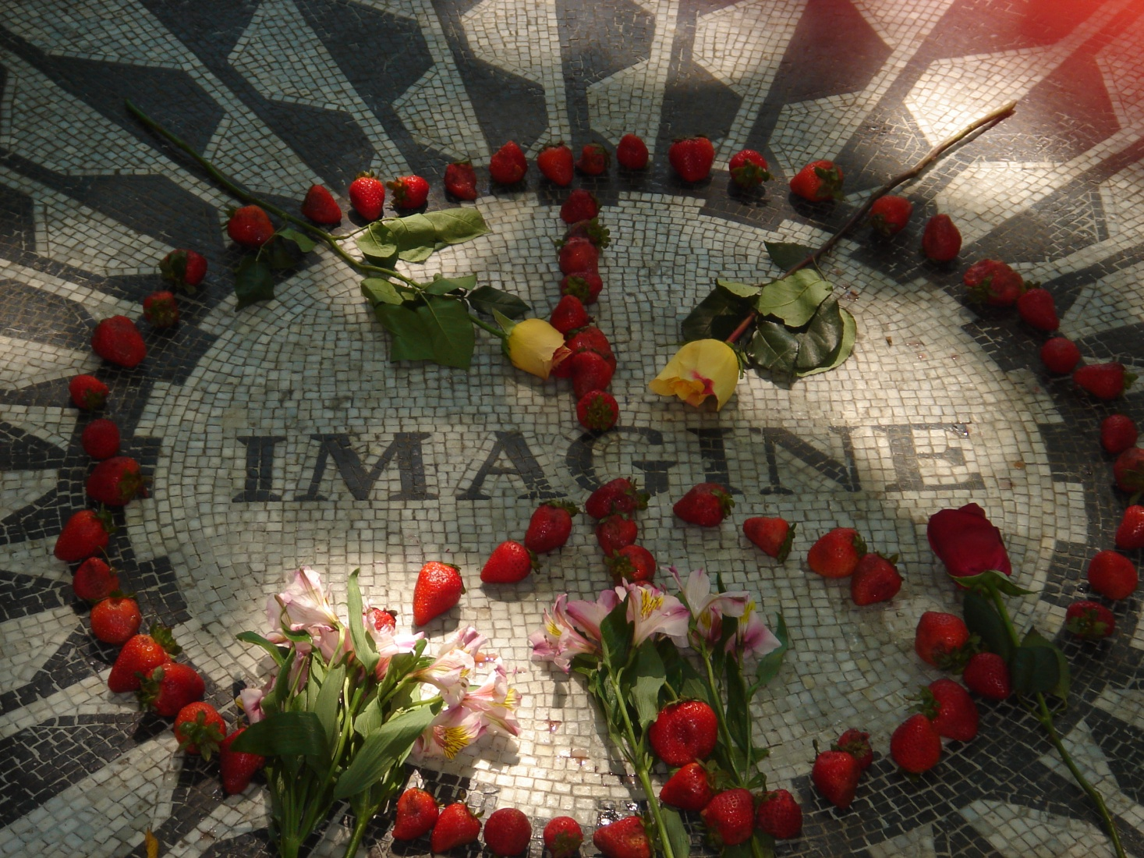

Slide 44
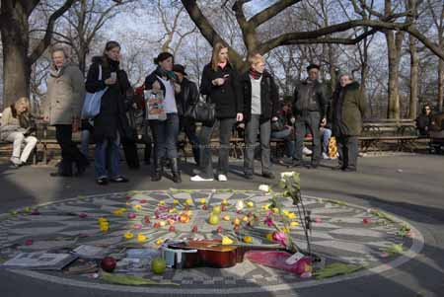

Slide 45
Yes we can!
‘Yes we can’ by Will I Am, is a different kind of protest song that was created to promote the election of Barack Obama for American President.
The song features one of Obama’s speeches set to music.
This song was redone with several artists singing it.
While the song didn’t protest anything, it did encourage people to vote for the first ever African America President in the USA.
http://www.youtube.com/watch?v=SsV2O4fCgjk&safety_mode=true&persist_safety_mode=1

Slide 46
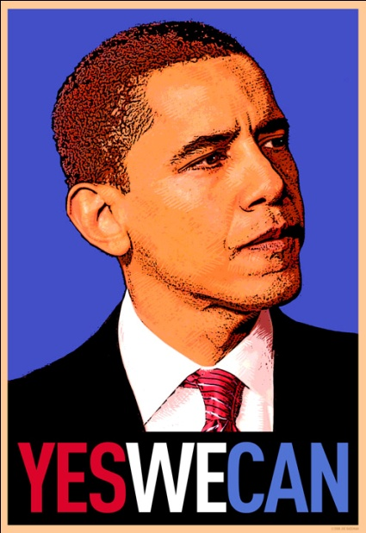
It was a creed written into the founding documents that declared the destiny of a nation. Yes we can. It was whispered by slaves and abolitionists as they blazed a trail toward freedom. Yes we can. Yes we can. It was sung by immigrants as they struck out from distant shores and pioneers who pushed westward against an unforgiving wilderness. Yes we can. Yes we can. It was the call of workers who organized; women who reached for the ballots; a President who chose the moon as our new frontier; and a King who took us to the mountain-top and pointed the way to the Promised Land. Yes we can to justice and equality. (yes we can, yes we can, yes we can, yes we can...)

